Slide 1
Cyber Security Breaches
Fox News Video: “World’s Biggest Cyber Attacks”
http://video.foxnews.com/v/5435057924001/?#sp=show-clips
World’s Biggest Data Breaches:
http://www.informationisbeautiful.net/visualizations/worlds-biggest-data-breaches-hacks/

Slide 2
Cyber Security Breaches
Leading Global Reports:
Verizon 2017 Data Breach Investigations Report (DBIR)
Symantec 2017 Internet Security Threat Report (ISTR)

Slide 3

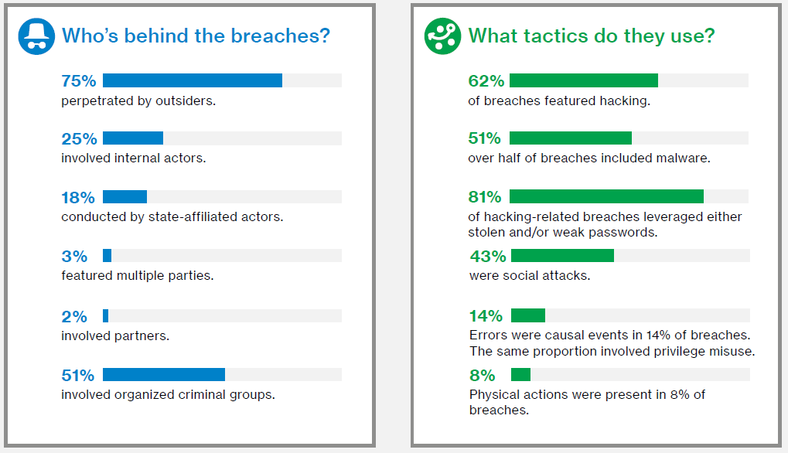
Cyber Security Breaches

Slide 4
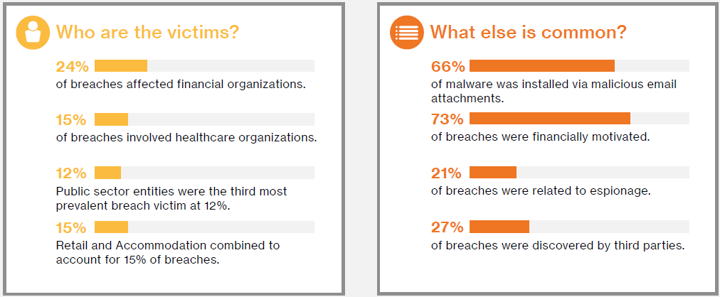
Cyber Security Breaches

Slide 5

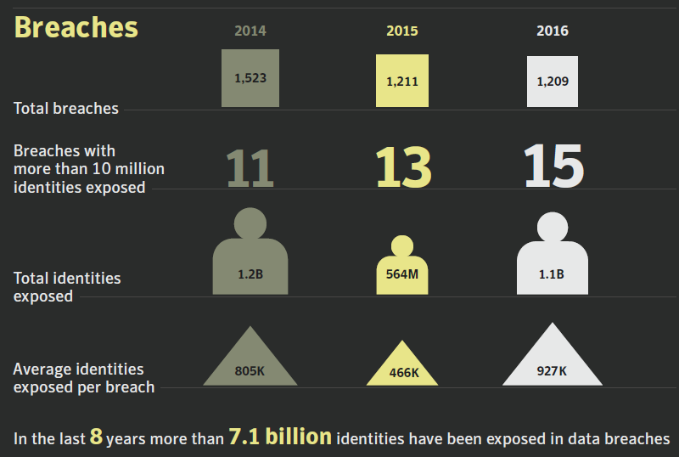
Cyber Security Breaches

Slide 6
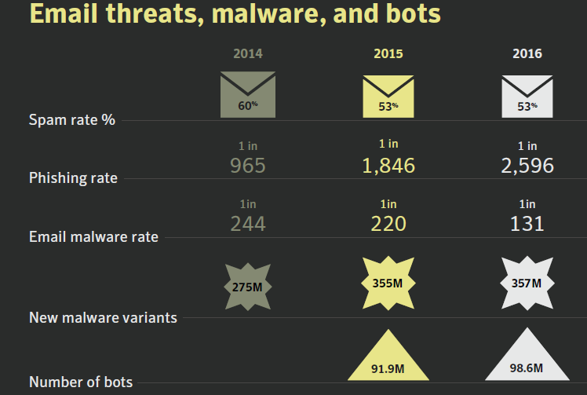
Cyber Security Breaches

Slide 7
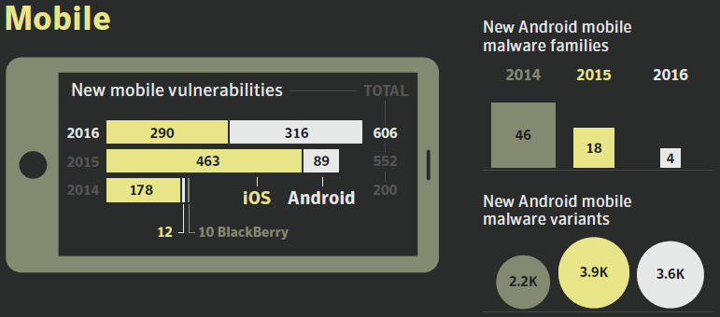
Cyber Security Breaches

Slide 8
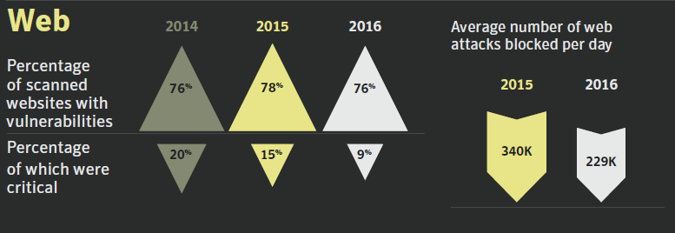
Cyber Security Breaches

Slide 9
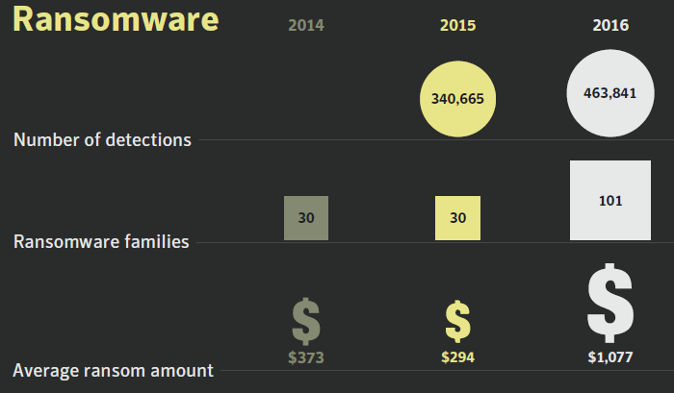
Cyber Security Breaches

Slide 10
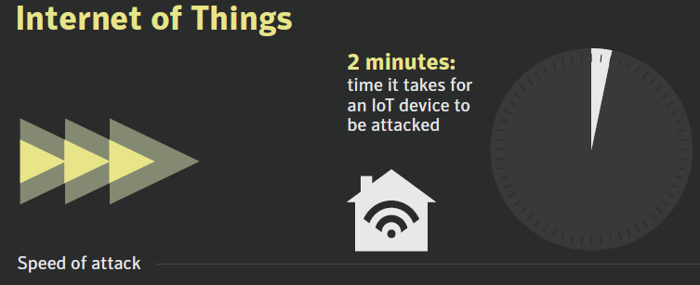
Cyber Security Breaches

Slide 11
Cyber Security Breaches
Leading Global Reports:
Verizon 2017 Data Breach Investigations Report (DBIR)
Symantec 2017 Internet Security Threat Report (ISTR)

